Slide 1



Slide 2
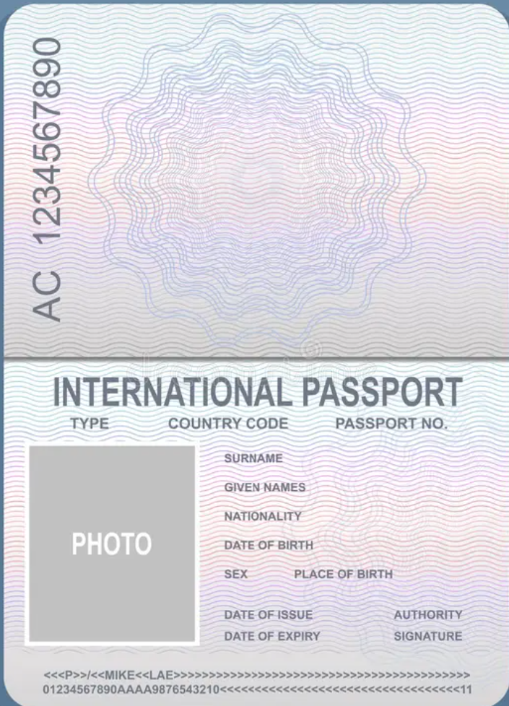
Ramirez Mena Andre Mexican 08/30/2015
M Guadalajara 08/15/2026 Never
Andre

Slide 3

Niagara falls
27 Aug 2026

Slide 4
Safari
ROM

Slide 5
Fort George Historic Site
Niagara on the Lake

Slide 6
Bird Kingdom
Welland Canal

Slide 7
Clifton Hill
Whirlpool

Slide 8
Nickel Beach
Water Park

